Slide 1
DSA2040 – Data Mining Project Brooklyn Ochieng- 666727 Maureen Maina - 667806 Michelle Kituku - 667351

Slide 2
Introduction
Introduction
A significant challenge faced by our subscription based service is the increasing rate of customer churn. Customers are unsubscribing from the application, leading to a decline in user base and revenue. High churn rates are particularly problematic for our subscription business as they directly impact revenue predictability, lifetime customer value, and overall profitability. It makes it harder to predict our income, and it costs more to get new customers than to keep old ones.
Objective
The main objective of this project is to identify the key factors that contribute to customer churn. By understanding the underlying causes, we aim to develop effective strategies to retain existing customers and minimize future churn.
Identify Key Churn Drivers: Use data mining to find significant churn influences (e.g., dissatisfaction, cost, age).
Develop Predictive Models: Create models to forecast potential churn.

Slide 3
Background
Churn rate is the percentage of subscribers who cancel subscriptions within a specific timeframe.
Importance: Identifying churn factors is essential for proactive retention measures.
Evolution:
Past methods relied on assumptions and anecdotal insights.
Modern approaches leverage data mining to uncover patterns in customer behavior.
Techniques:
Tools like correlation analysis, decision trees, and regression models.
Analyzing historical data to predict future churn and implement preventive measures.

Slide 4
Model
Chosen Model: Random forest classifier
It is a machine learning pipeline to predict customer churn (churning status) in a customer dataset.
First pipeline
The first pipeline trains a Random Forest Classifier without class balancing (class_weight=None). The dataset is split into an 80-20 training-test set, maintaining the target class distribution through stratification.
Second pipeline
The second pipeline addresses class imbalance by using a Random Forest Classifier with class_weight='balanced'. This adjustment increases the focus on correctly classifying the minority class by weighting each class inversely proportional to its frequency.

Slide 5
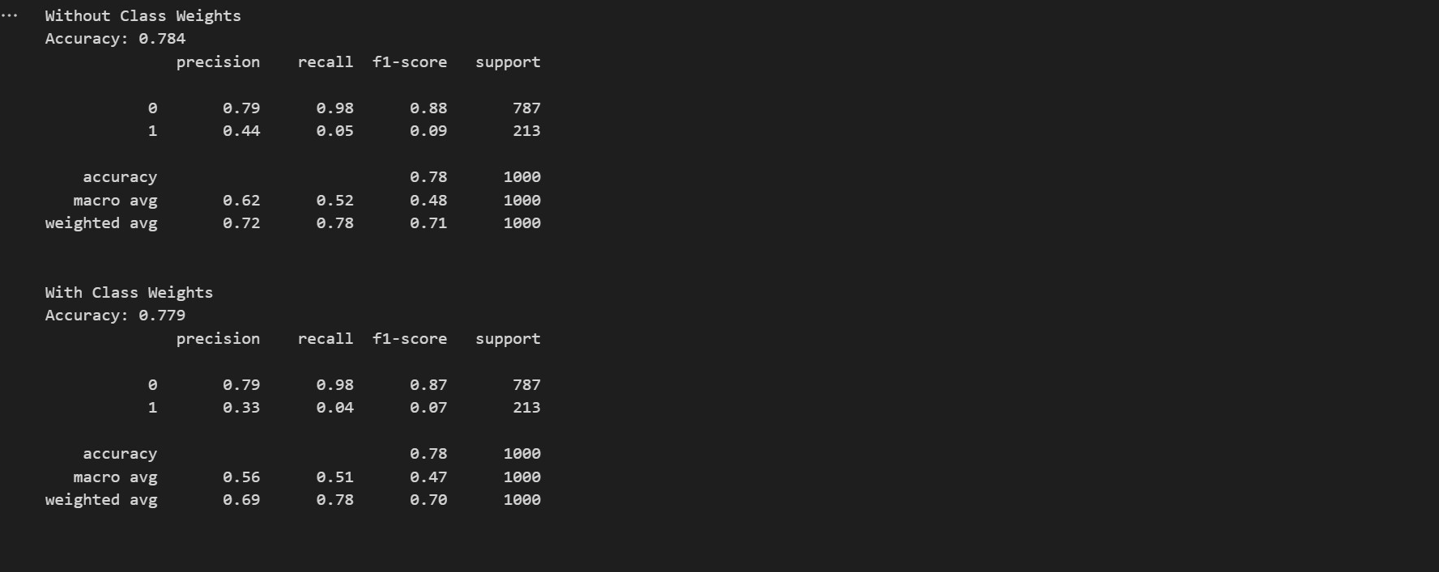
Output of the code

Slide 6
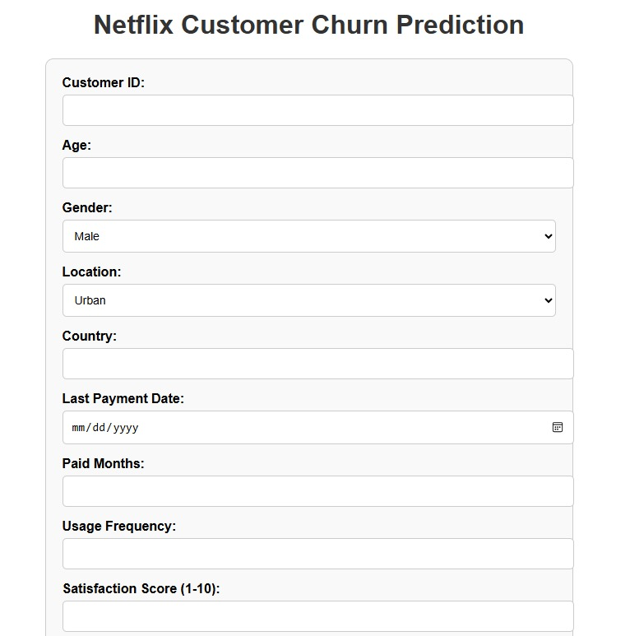
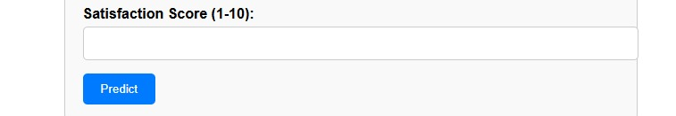
Output of the code using flask

Slide 7
Recommendations
Content Development: Create targeted content for male and youth demographics to align with their preferences and foster loyalty.
Standard Plan Review: Reevaluate features and pricing to enhance perceived value and prevent overspending concerns.
Feedback Collection: Regularly gather detailed customer feedback to understand needs and improve loyalty
Marketing Alignment: Ensure social media marketing aligns with app offerings to manage user expectations.
Urban Engagement: Provide exclusive, localized content or benefits to boost engagement among urban users.
Enhanced Features: Develop high-quality animations to sustain the interest of younger users.

Slide 8
Future improvements
Real-Time Predictions: Implement machine learning models to predict churn and identify at-risk users proactively.
Targeted Surveys: Conduct surveys to validate churn reasons and obtain direct user feedback.
Behavior Analysis: Study long-term user behavior to spot trends and enhance retention strategies.
Flexible Pricing: Test variable subscription pricing to cater to diverse user segments.
Rural Expansion: Investigate rural areas with lower churn rates as they may represent untapped potential.

Slide 9
thank you

